Slide 1

Exploratory Data Analysis Final Project: Where to park a food truck?
By Heather Swanke

Slide 2
Introduction
My client is a chef/restauranteur looking for the ideal parking locations for a food truck
Goal: find locations near high traffic MTA entrances to maximize revenue during lunch & dinner hours
Understanding historical data trends for weekdays, weekends, and rainy days can help with forecasting food inventory to meet future demand

Slide 3
Data Description
MTA turnstile data
Entry data for individual turnstiles during 4-hour time blocks
2.75 million rows
NOAA weather data
91 daily NYC precipitation totals for inches of rain
Timeframe for analysis: 4/1/2021 - 6/30/2021 (both datasets)
Imported and merged data in python
Cleaned, aggregated, & visualized data using:
Pandas
Matplotlib
Seaborn
Visualizations filtered based on entry data for 12-8pm

Slide 4
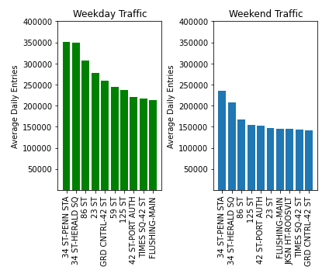
Results
Top 10 stations based on average daily entries per weekday or weekend day
Weekday commuter traffic is higher volume than weekend leisure traffic, even after COVID
59 ST & JKSN HT-ROOSVLT each appear on 1 list, other stations appear on both

Slide 5
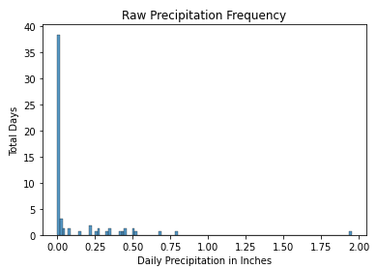
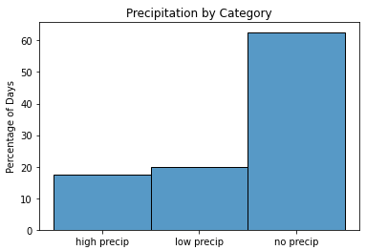
Results
To help understand precipitation frequency, I created 3 categorical precipitation bins
high precipitation: >= .25 in
low precipitation: < .25 in
no precipitation: 0 in

Slide 6
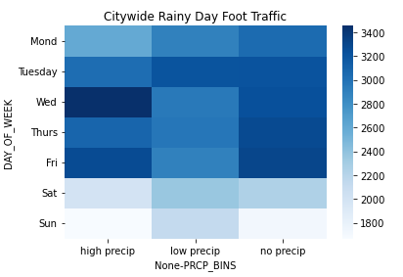
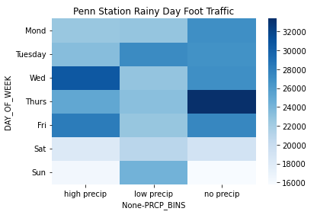
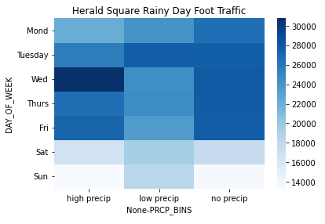
Results
Precipitation does not have a consistent negative impact on foot traffic
I looked at NYC city wide average foot traffic and drilled down to the top 2 high traffic stations
If rain was a consistent detriment to foot traffic, there would be steadily darker colors as you move right for each day of the week. Instead, most weekdays have slightly lighter colors in the middle on low precipitation days.

Slide 7
Conclusion
Food truck should target high volume stations like 34 ST-PENN STA & 34 ST-HERALD SQ rain or shine!
Weekdays with low precipitation (rain under .25 inches) have slightly lower volume than weekdays with high precipitation across the city
Be prepared for lower demand on the weekends
Future Work
Does snow impact foot traffic?
How does 2022 demand compare to 2021 demand?

Slide 8
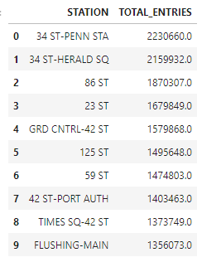
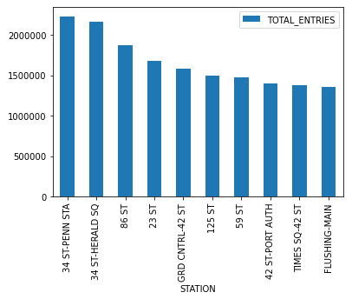
Appendix
Top 10 stations for overall total entries

Slide 9
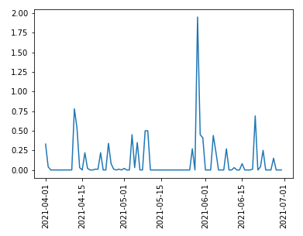
Appendix
Time series of precipitation provides insight on weather patterns in NYC

